Slide 1
HAND GESTURE DETECTION MODEL USING PYTHON
Under the Supervision of
Dr. B.K. SHARMA SIR

Slide 2
Introduction
The Government of India formulated the National Policy for Persons with Disabilities in February 2006 which deals with Physical, Educational & Economic Rehabilitation of persons with disabilities. In addition the policy also focuses upon rehabilitation of women and children with disabilities, barrier free environment, social security, research etc.
Hands are human organs which are used to manipulate physical objects. For this very reason hands are used most frequently by human beings to communicate and interact with machines.
If computer had the ability to translate and understand hand gestures. it would be a leap forward in the field of human computer interaction. The dilemma faced with this is that the images these days are information rich and in-order to achieve this task extensive processing is required. Every gesture has some distinct features which differentiates it from other gestures.

Slide 3
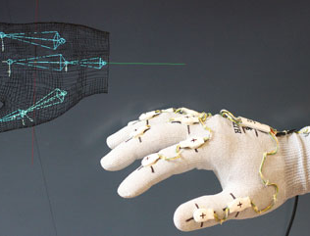
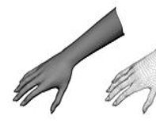
Techinques used for gestures
Glove based Analysis” attaching sensor with gloves mechanical or optical to transduces flexion of fingers into electrical signals for hand posture determination and additional sensor for position of the hand. This sensor is usually an acoustic or a magnetic that attached to the glove.
The second approach is “Vision based Analysis” that human beings get information from their surroundings, and this is probably most difficult approach to employ in satisfactory way. Many different implementations have been tested so far. One is to deploy 3-D model for the human hand. Several cameras attached to this model to determine parameters corresponding for matching images of the hand, palm orientation and joint angles to perform hand gesture classificationions to recognize hand posture
This Photo by Unknown author is licensed under CC BY.

Slide 4
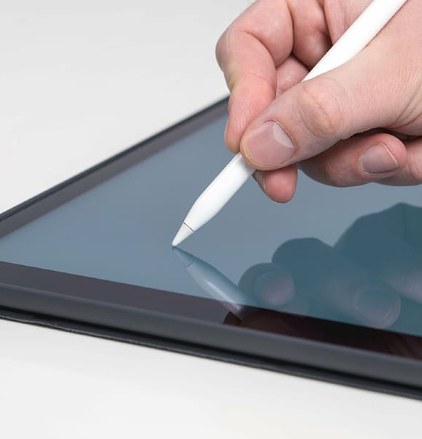
The Third implementation is “Analysis of drawing gesture” use stylus as an input device. These drawing analysis lead to recognition of written text. Mechanical sensing work has used for hand gesture recognition at vast level for direct and virtual environment manipulation. Mechanically sensing hand posture has many problems like electromagnetic noise, reliability and accuracy. By visual sensing gesture interaction can be madepotentially practical but it is most difficult problem for machines
Types of gestures
consider online gestures, which can also be regarded as direct manipulations like scaling and rotating. In contrast, offline gestures are usually processed after the interaction is finished
Offline gestures: Those gestures that are processed after the user interaction with the object. An example is the gesture to activate a menu.
Online gestures: Direct manipulation gestures. They are used to scale or rotate a tangible object.

Slide 5
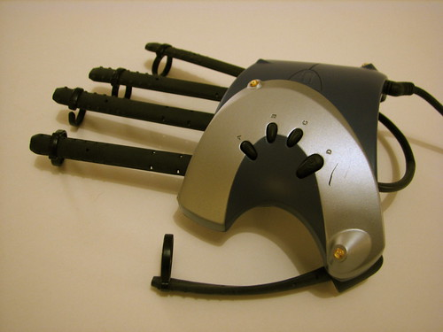
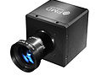
Different input
Wired gloves. These can provide input to the computer about the position and rotation of the hands using magnetic or inertial tracking devices. Furthermore, some gloves can detect finger bending with a high degree of accuracy (5-10 degrees), or even provide haptic feedback to the user, which is a simulation of the sense of touch.
Depth-aware cameras. Using specialized cameras such as structured light or time-of-flight cameras, one can generate a depth map of what is being seen through the camera at a short range, and use this data to approximate a 3d representation of what is being seen. These can be effective for detection of hand gestures due to their short range capabilities
Stereo cameras. Using two cameras whose relations to one another are known, a 3d representation can be approximated by the output of the cameras. To get the cameras' relations, one can use a positioning reference such as a lexian-stripe or infrared emitters.
This Photo by Unknown author is licensed under CC BY-SA.
This Photo by Unknown author is licensed under CC BY-NC.

Slide 6
Gesture-based controllers. These controllers act as an extension of the body so that when gestures are performed, some of their motion can be conveniently captured by software. An example of emerging gesture-based motion capture is through skeletal hand tracking, which is being developed for virtual reality and augmented reality applications
Single camera. A standard 2D camera can be used for gesture recognition where the resources/environment would not be convenient for other forms of image-based recognition. Earlier it was thought that single camera may not be as effective as stereo or depth aware cameras, but some companies are challenging this theory. Software-based gesture recognition technology using a standard 2D camera that can detect robust hand gestures.
This Photo by Unknown author is licensed under CC BY-SA-NC.

Slide 7
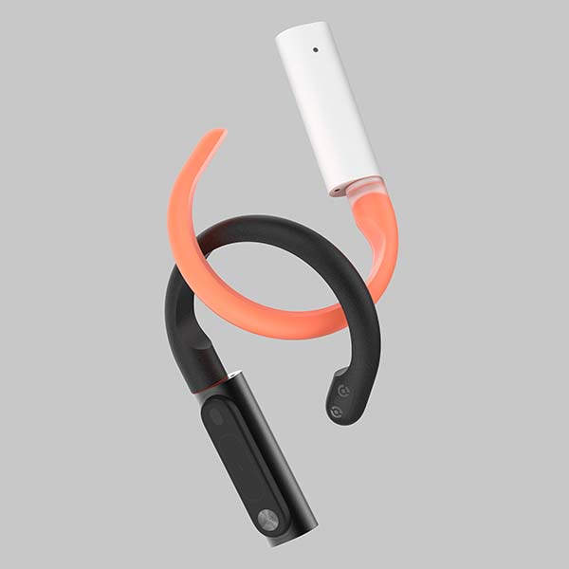
DIFFERENT RECOGNITION APPROACHES
PEN-BASED GESTURE RECOGNITION
Recognizing gestures from two-dimensional input devices such as a pen or mouse has been considered for some time. The early Sketchpad system in 1963 used light-pen gestures, for example. Some commercial systems have used pen gestures since the 1970s. There are examples of gesture recognition for document editing for air traffic control, and for design tasks such as editing splines
TRACKER-BASED GESTURE RECOGNITION
There are many tracking system available commercially which can used for gesture recognition, primarily tracking eye gaze, hand gesture, and overall body and its position. In virtual environment interaction each sensor has its own strengths and weaknesses. Gestural interface eye gaze can be useful
This Photo by Unknown author is licensed under CC BY-SA-NC.

Slide 8
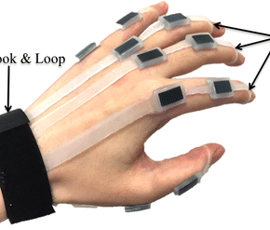
DATA GLOVES GESTURE RECOGNISATION
taxonomy of whole-hand input that categorizes input techniques along two dimensions: Classes of hand actions that could be continuous or discrete and interpretation of hand actions that could be direct, mapped, or symbolic
These devices include exoskeleton and instrumented gloves mounted on hand and figure that are known as “Data gloves”. Few advantages of data gloves, direct measurement of hand and finger parameters, provision of data, high sampling frequency, easy if use, line of sight, low cost version and translation independency feature of data
VISION-BASED GESTURE RECOGNITION
Only a single camera is used which captures the image of hands which is used for interactionbetween human and computers.
This Photo by Unknown author is licensed under CC BY.

Slide 9
Choosing appropriate technique
Glove based technique
More hardware needed
More training needed
Expensive
Non mobility of system
Complexity in structure
Analysis by drawing gestures
Stylus or similar input hardware needed
Touch screens will be needed
More expensive
Electromagnetic noise
Human errors

Slide 10
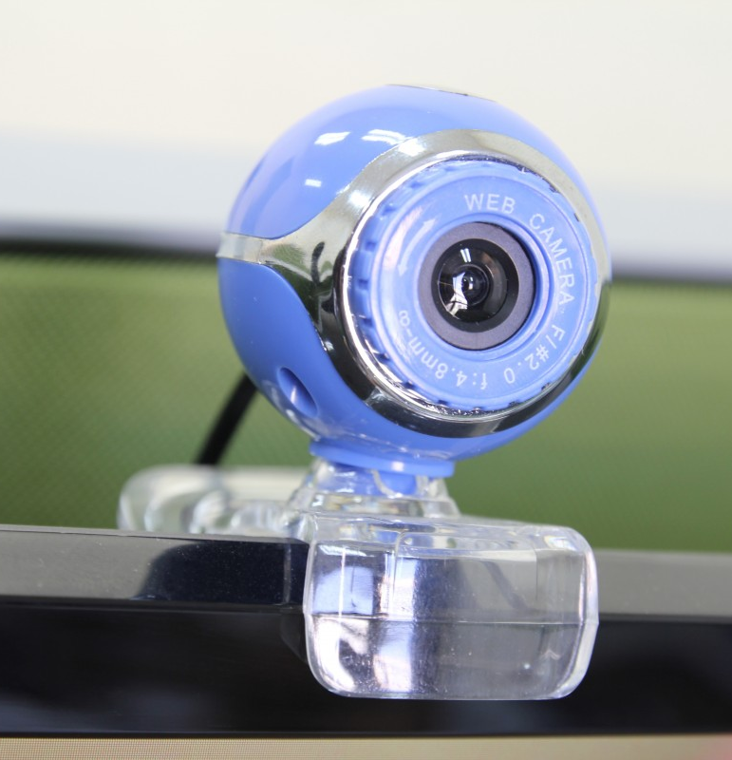
Vision based analysis
A camara will be needed
Appropriate coding and software devlopment
Process in a simpler and faster way: it allows the clients and industries to check. Also, it gives them access to their products. It’s possible thanks to the existence of Computer Vision in fast computers.
Reliability: computers and cameras don’t have the human factor of tiredness, which is eliminated in them. The efficiency is usually the same, it doesn’t depend on external factors such as illness or sentimental status.
Accuracy: the precision of Computer Imagining, and Computer Vision will ensure a better accuracy on the final product.
A wide range of use: We can see the same computer system in several different fields and activities. Also, in factories with warehouse tracking and shipping of supplies, and in the medical industry through scanned images, among other multiple options.
The reduction of costs: time and error rate are reduced in the process of Computer Imagining. It reduces the cost of hire and train special staff to do the activities that computers will do as hundreds of workers.

Slide 11
Choosing appropriate input technique
data glove-there are few disadvantages like difficulty in calibration, reduction in range of motion and comfort, noise in inexpensive system, expensiveness of accurate system. Moreover it‟s compulsory for user to wear cumbersome device.
tracker-based systems-This detracts from the immerse nature of a virtual environment by requiring the user to put on an unnatural device that cannot easily be ignored, and which often requires significant effort to put on and calibrate. Even optical systems with markers applied to the body suffer from these shortcomings, albeit not as severely.
Camera-cost efficient,no need of caliberation, popularity led to accessibility ,no wearable needed no training needed to use

Slide 12
Keras vs tensorflow vs pytorch
comparision
 | Keras | Tensorflow | pytorch
overview | Keras is an open source neural network library. It is designed to enable fast experimentation with deep neural networks. | TensorFlow is an library for dataflow programming across a range of tasks. It is a symbolic math library that is used for machine learning applications like neural networks. | PyTorch is an open source machine learning library for Python, based on Torch. It is used for applications such as natural language processing
API | High level API | Both high and low API | Lower level API
speed | Slow speed | High speed | High speed
 | Simple readable and concise | Complex and readability | Complex
Debugging | Easy debugging | Difficult debugging | Best debugging
dataset | Small dataset | Large dataset | Large dataset

Slide 13
Terminologies
Computer Vision :- It is an interdisciplinary scientific field that deals with how computers can gain high-level understanding from digital images or videos.
Artificial Intelligence :- It is the simulation of human intelligence processes by machines, especially computer systems.
Machine Learning :- It is an application of artificial intelligence(AI) that provides systems the ability to automatically learn and improve from experience without being explicitly programmed.

Slide 14
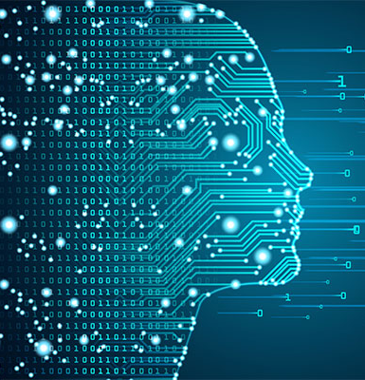
Deep Learning
Deep learning is an AI function that mimics the workings of the human brain in processing data for use in detecting objects, recognizing speech, translating languages, and making decisions.
Deep learning AI is able to learn without human supervision, drawing from data that is both unstructured and unlabeled.
In deep learning, a computer model learns to perform classification tasks directly from images, text, or sound. Deep learning models can achieve state-of-the-art accuracy, sometimes exceeding human-level performance. Models are trained by using a large set of labelled data and neural network architectures that contain many layers.

Slide 15
Deep learning models
Artificial neural networks(ANN) used for Regression and classification
Convolutional Neural network(CNN) used for Computer Vision
Recurrent Neural Networks (RNN) used for Time Series analysis

Slide 16
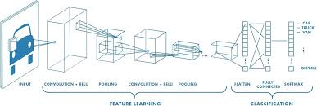
Convolutional neural network (CNN)
In neural networks, Convolutional neural network (ConvNets or CNNs) is one of the main categories to do images recognition, images classifications. Objects detections, recognition faces etc., are some of the areas where CNNs are widely used.
CNN image classifications takes an input image, process it and classify it under certain categories (Eg., Dog, Cat, Tiger, Lion). Computers sees an input image as array of pixels and it depends on the image resolution. Based on the image resolution, it will see h x w x d( h = Height, w = Width, d = Dimension ). Eg., An image of 6 x 6 x 3 array of matrix of RGB (3 refers to RGB values) and an image of 4 x 4 x 1 array of matrix of grayscale image.

Slide 17
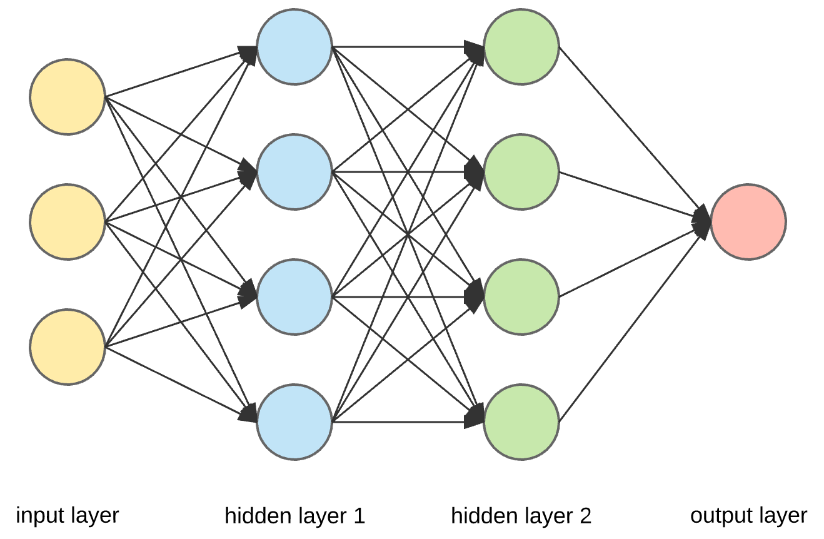
Technically, deep learning CNN models to train and test, each input image will pass it through a series of convolution layers with filters (Kernals), Pooling, fully connected layers (FC) and apply Softmax function to classify an object with probabilistic values between 0 and 1. The below figure is a complete flow of CNN to process an input image and classifies the objects based on values
Convolution is the first layer to extract features from an input image. It is a mathematical operation that takes two inputs such as image matrix and a filter or kernel.

Slide 18
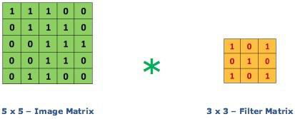
Then the convolution of 5 x 5 image matrix multiplies with 3 x 3 filter matrix which is called “Feature Map” as output shown in below. Convolution of an image with different filters can perform operations such as edge detection, blur and sharpen by applying filters.

Slide 19
Implementation We have Created 3 Modules
Collect-data.py
Train.py
Predict.py

Slide 20

Collect-data.py
In this module we will be collecting data/images that is appropriate for training purpose.
Libraries used :
Opencv
Numpy
Os

Slide 21
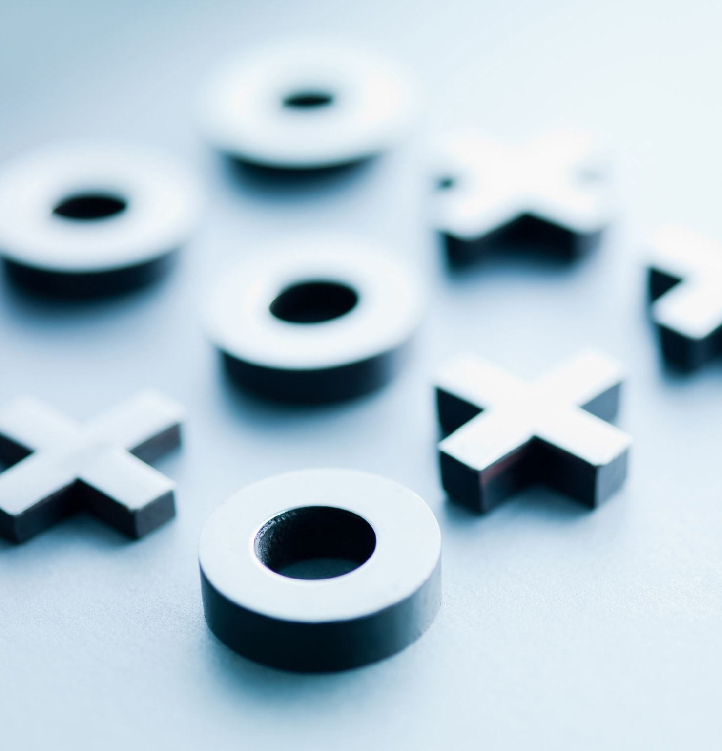
Working
We will be creating directories to store the images that will be later used for training .
We will be selecting a R.O.I
We will be capturing images from R.O.I and resizing it to (64,64)
We will be converting those images/frames to grayscale images

Slide 22
Working
Then we will be converting grayscale to complete binary image (i.e black and white)
And finally we will be storing these images to appropriate directory made earlier.
*We can add images as much as we want .

Slide 23
Train.py
In this module we will be training the data which we have collected by collect-data.py module.
Libraries used :- Keras

Slide 24
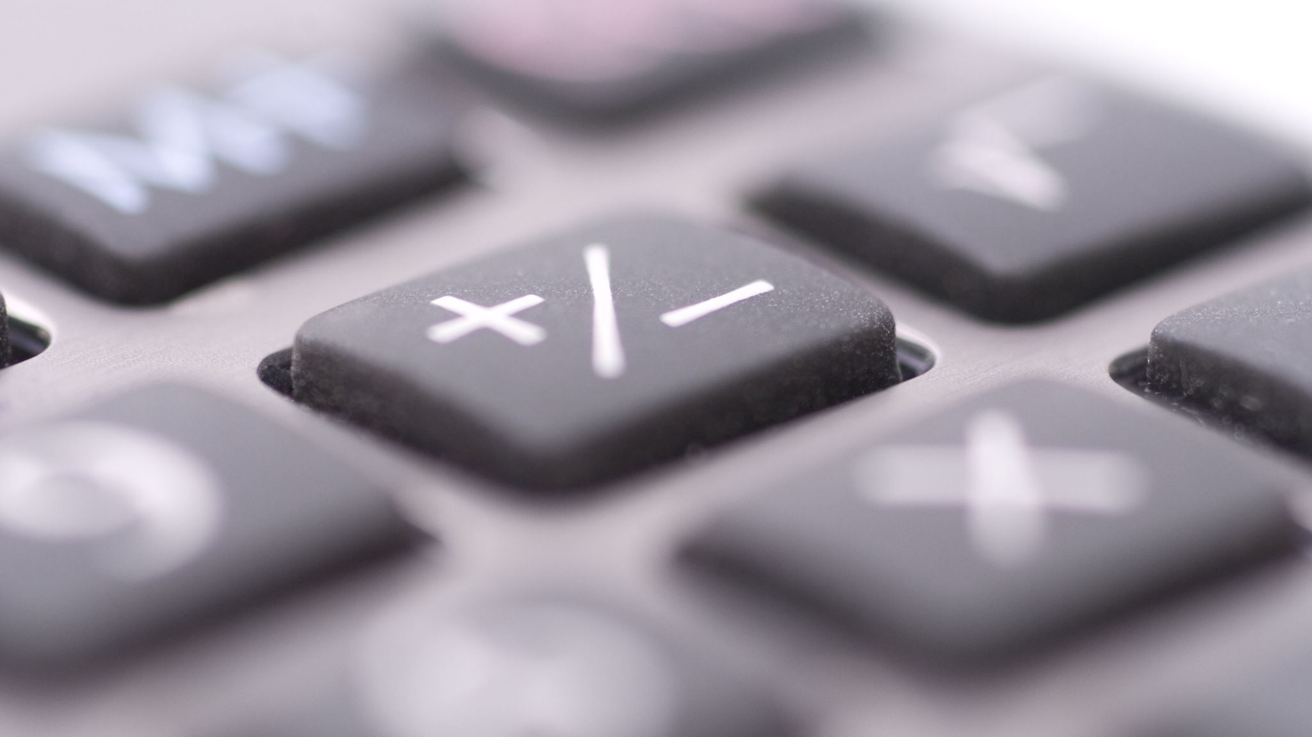
Working
Initializing classifier object using sequential() class and adding layers one by one on it .
Adding First convolution layer and pooling :
No. of filters/features = 32
Inputshape(64,64,1)

Slide 25

Working
Activation function = RELU
Polling : The input image is down sampled or converted to a low resolution version in order to keep only the significant details and remove the finer less important details.

Slide 26
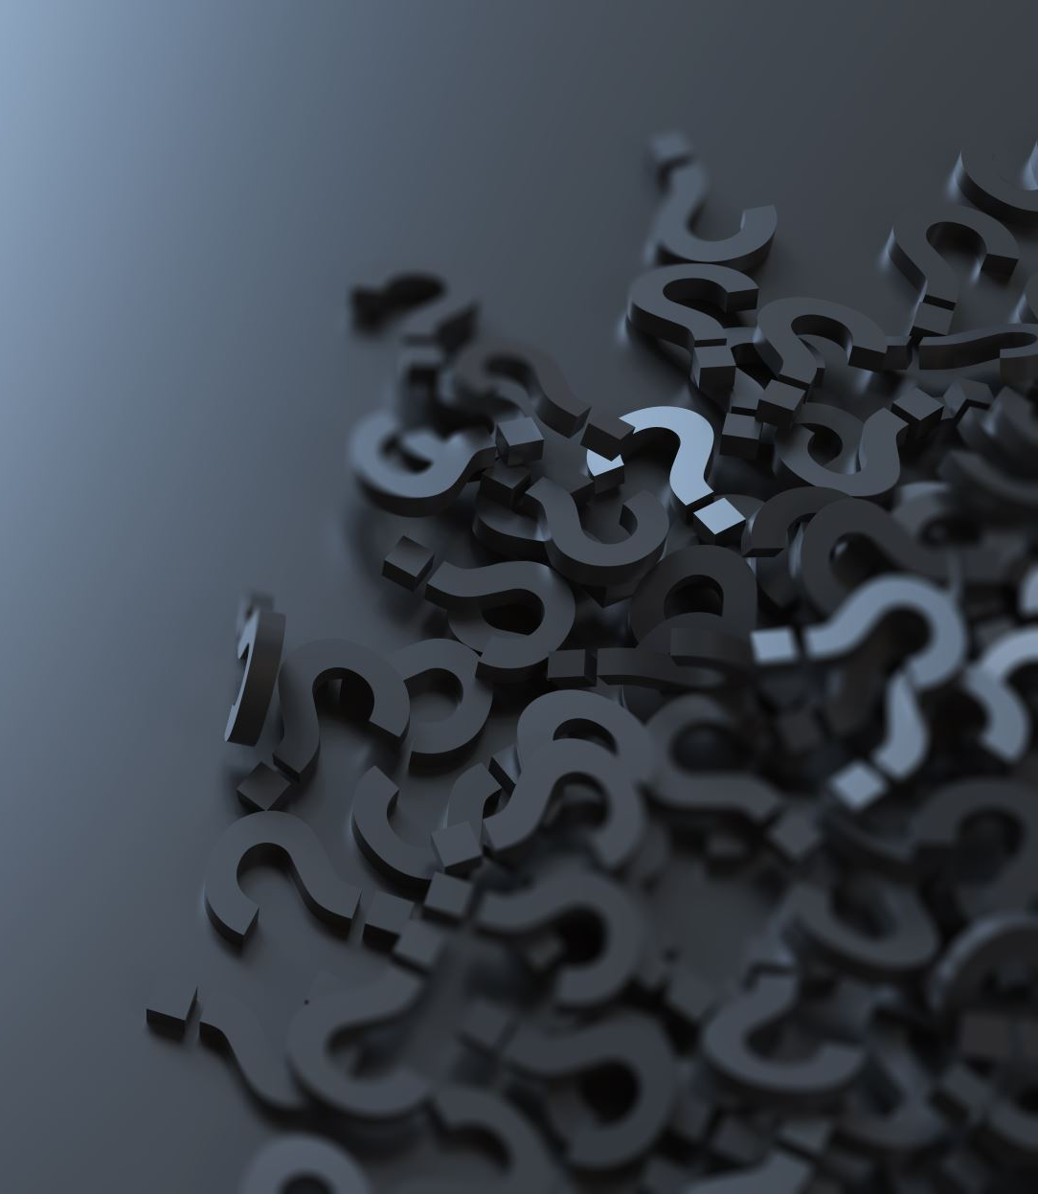
Working
Adding second convolution layer and pooling :
Input_shape is going to be the pooled feature maps from the previous convolution layer .
Flattening the layers : after these all we will be having layer which are 2d arrays which in this step we are converting into 1d array. By using flatten function.
Now we have a fully connected layer and we will add this layer using dense fuction through our neural network

Slide 27
Working
Compiling the CNN
Now taking the images and feeding to the neural network using keras.preprocessing.image module
Training the model by fitgenerator method
training_set
steps_per_epoch=600, # No. of images in training set
epochs=10
in last we will be saving the model in a model.json file and weights in model.h5 file

Slide 28
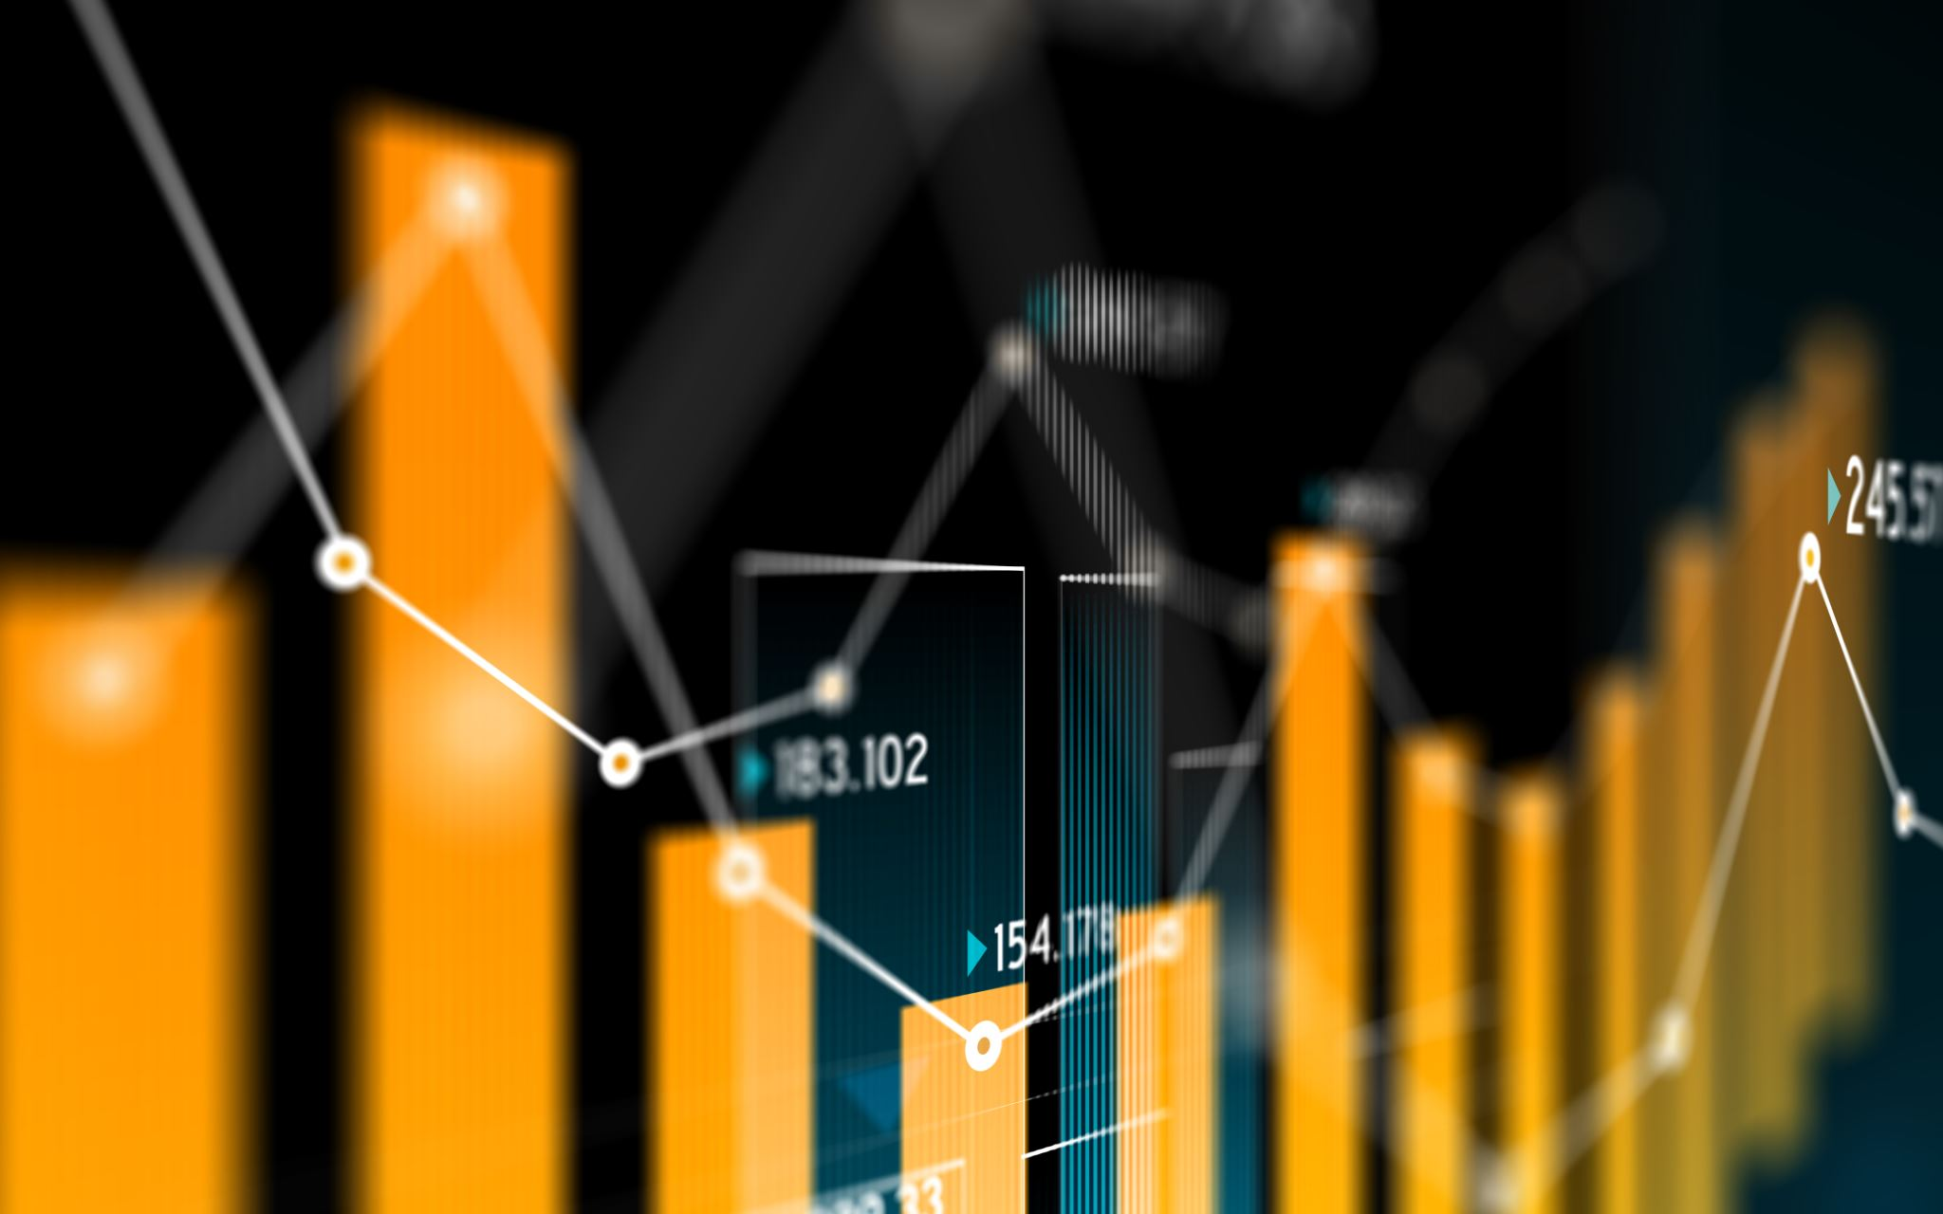
Predict.py
In this module we will making the predict by capturing the hand gestures and comparing it with our trained data.
Libraries used :
Opencv
Numpy
Os

Slide 29

Working
Loading the saved model
Loaded the weights
Started capturing real time image
Selecting the R.O.I
Extracting the R.O.I
Resizing the data from R.O.I and converting it to gray and the to binary
Showing the real time binary image to user

Slide 30

working
Now using predict function predicting the data
It takes the input image as a parameter and predicts the class it belongs to. Before passing the image, we need to ensure that we are using the same dimensions that we used during the training phase.
Showing the prediction class to user

Slide 31
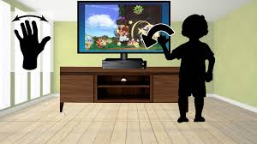
A Glimpse of the Future
An easier life for the disabled
Alternative computer interfaces
Entertainment applications
Automation systems

Slide 32

Thank You

